Slide 1

Data cleaning, Anlysis & visualization using python
Data cleaning, Analysis & visualization using python

Slide 2
Objectives
Import & clean the Prime video OTT dataset using libraries in python(e.g. pandas, numpy)
Analyze data trends and distribution using summary statistics & visualization in python.
Create charts like bar charts histogram chart pie chart with matplotlib and seaborn.
Extra key trends and patterns, such as top and realse year trends.

Slide 3
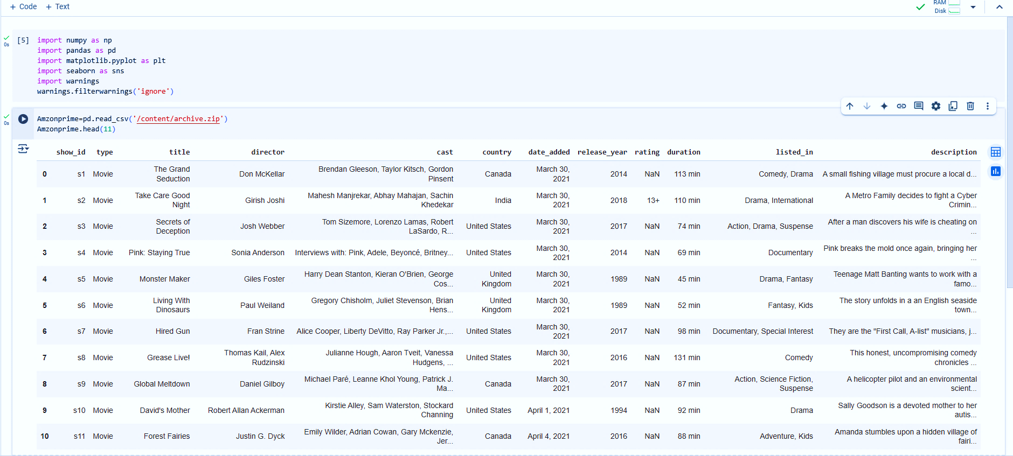
Importing libraries & Modules

Slide 4
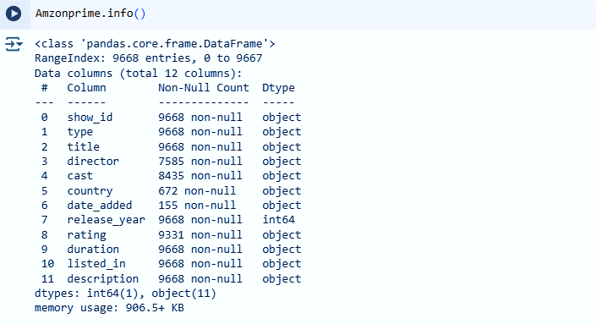
Checking the info

Slide 5
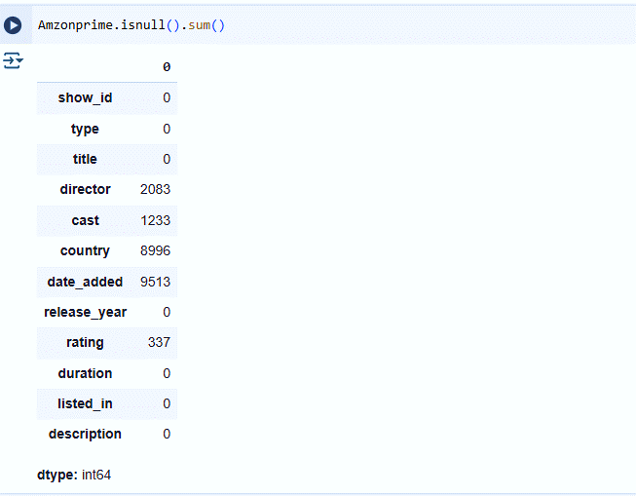
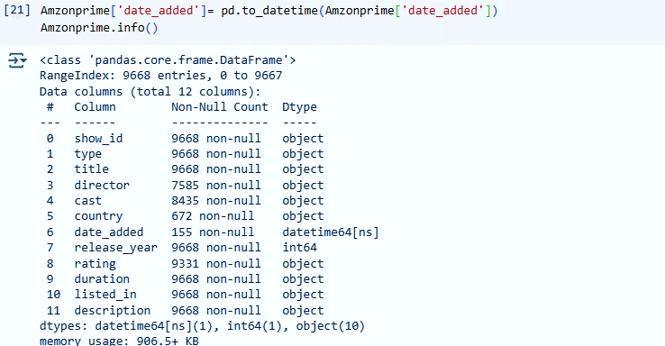
Data cleaning

Slide 6
Checking for duplicates values

Slide 7
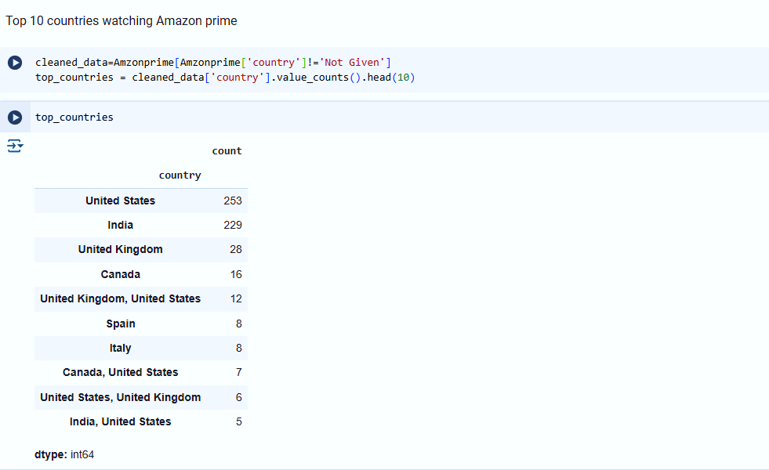
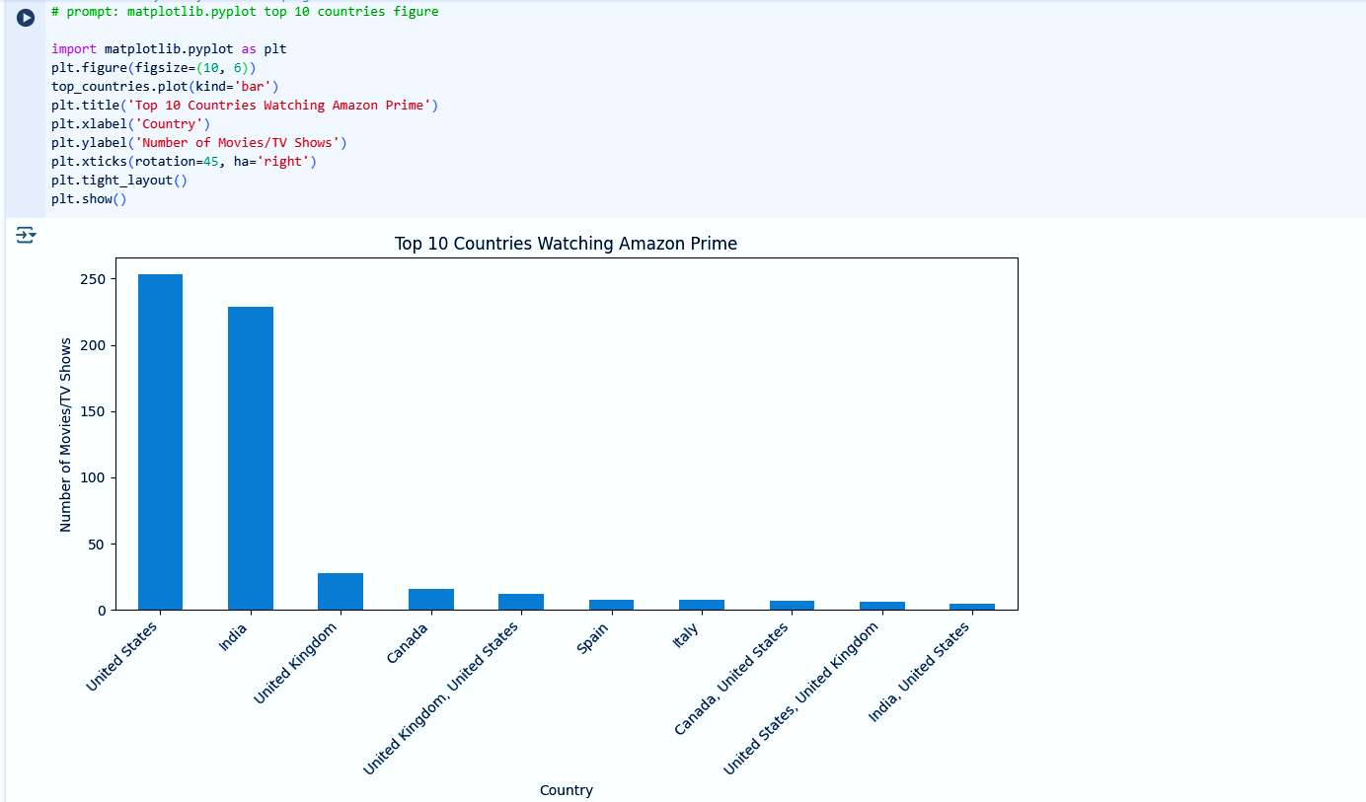
Top 10 countries by user

Slide 8
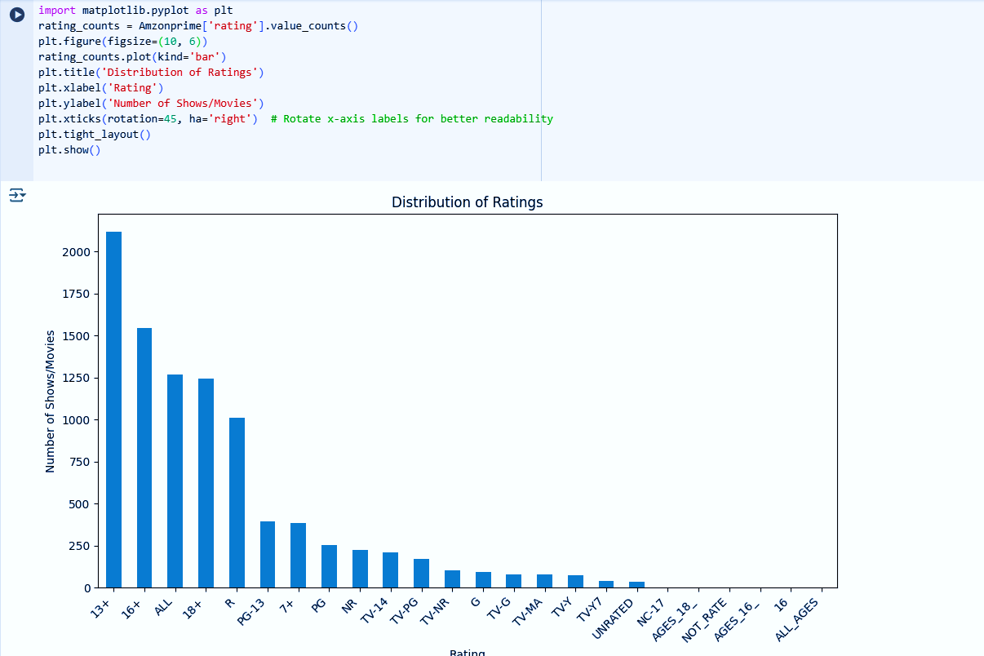
Ratings on Prime videos

Slide 9
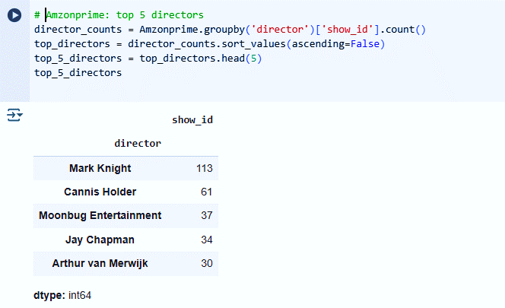
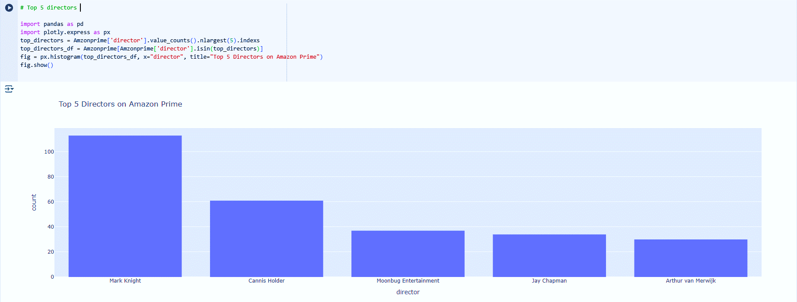
Top 5 directors

Slide 10
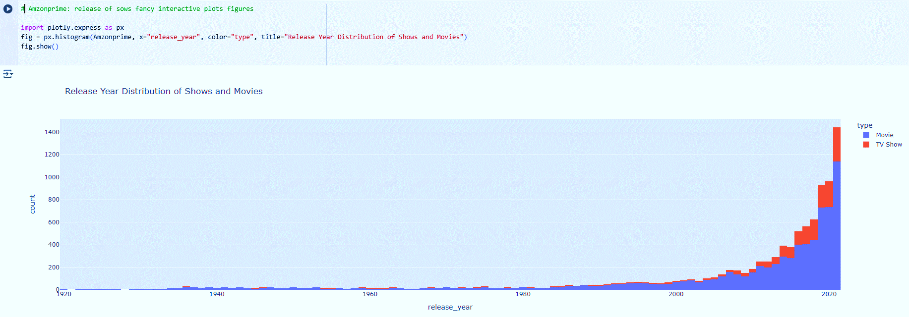
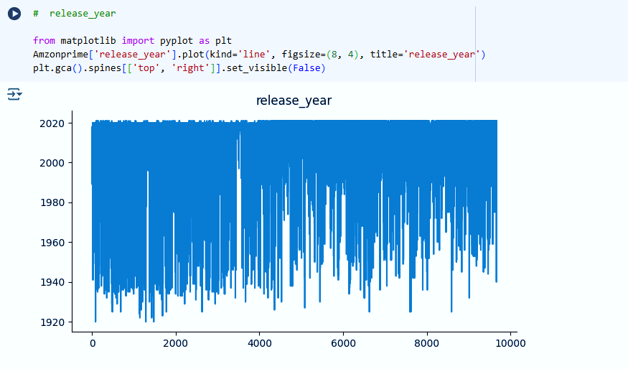
Yearly Releases of shows & movies

Slide 11
Key insights
Key insights
The number of Amazon Prime Video releases has increased over time, with a peak in recent years.
Movies dominate the platform compared to TV shows.
The U.S. and India have the highest number of available titles
Drama, Comedy, and Action are the most common genres Certain genres like Documentary and Horror have niche audiences.
IMDb ratings show a skewed distribution, with most content rated between 6-8
Older content (before 2000) has fewer titles available. Recent years (2015–2023) have the highest number of releases.
Missing IMDb ratings and metadata for some titles.
The number of Amazon Prime Video releases has increased over time, with a peak in recent years.
Movies dominate the platform compared to TV shows.
The U.S. and India have the highest number of available titles
Drama, Comedy, and Action are the most common genres.Certain genres like Documentary and Horror have niche audiences.
IMDb ratings show a skewed distribution, with most content rated between 6-8
Older content (before 2000) has fewer titles available. Recent years (2015–2023) have the highest number of releases.
Missing IMDb ratings and metadata for some titles.

